Slide 1
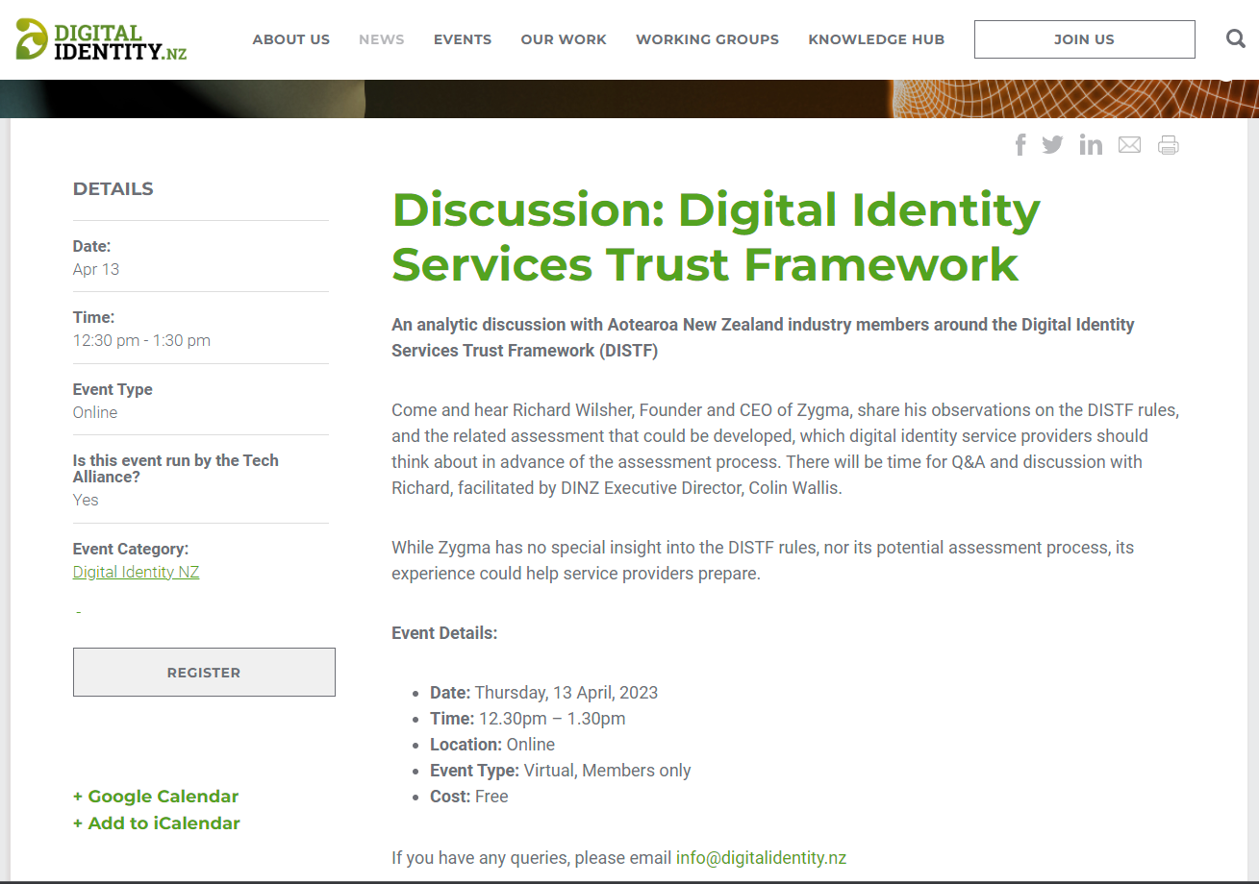
questions?
START THE SHOW

Slide 2
An analytic discussion with Aotearoa | New Zealand industry members around the DIS TF Richard G. Wilsher CEO & Founder, Zygma Inc. RGW@Zygma.biz 2023-04-13

Slide 3
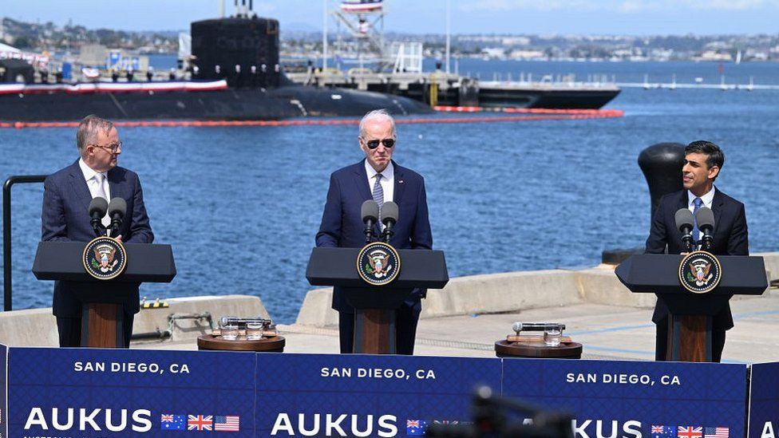
My Credentials I (or are they Attributes?)
AUKUS Vagrant - UK - US - AU

Slide 4
My Credentials II
E-signature standardisation in Europe from 1993
Established the first identity Trust Framework (UK, 2000, tScheme)
Principal Architect - US Federal E-Authentication Initiative (2005) - Electronic Authentication Partnership - …. Kantara Initiative
Kantara-Accredited Assessor

Slide 5
My Credentials III
US Contributor, ISO/SC 27/WG 1 & WG 5 - ISO/IEC 27001 family (Infosec management) - ISO/IEC 29003 (Identity proofing) - ISO/IEC 29115 (Entity authentication assurance framework) - ISO/IEC 29146 (Framework for access management)
ISMS Implementer, Auditor, Trainer - ISO 17020, 17065, 19011, … (Accreditation & Certification)

Slide 6
Disclaimers / Qualifiers
NOT extensively familiar with DISTF
HAVE reviewed the Bill, Assurance Standards, Rules, …
An absolute authority on NOTHING!!
NO axe to grind
AM a little confused
What if I’m wrong?
I know its hard to build a glass house …

Slide 8
TF Operational Goals
Clarity as to what MUST/SHALL be done
❶
Clear and unambiguous criteria (requirements) - Expressly Normative - Optional with expressly normative consequences
❷
Easily related to a specific scope of service
❸
Measurable conformity
❹
Defined skills / knowledge / experience of assessors
❺
Defined rules / processes for both Service Providers and their Assessors to make application for and to maintain recognition
❻
Defined rules / processes whereby the TFA processes applications; reviews assessor reports; decides, revokes and/or suspends recognition; publishes and notifies of recognition statuses

Slide 9
What did I like?
The substantive set of requirements and obligations set out by the Bill
The idea of approving service providers as well as their distinct services
The Assurance Standards are clear about the normative controls and their rationale/other guidance. These two elements are kept distinct and separate. … however …

Slide 10
Clear, Unambiguous Criteria ?
❶
4 Assurance Standards (Identity Management Standards)
9 Rules categories (Rules) - 5 Identity services - 4 other ‘Rules’ categories
No expressly-stated relationship has been identified Implication that Rules > Assurance Standards by referring to them (no references to Rules from Standards have been identified)
No clear indication of how to apply the Rules and IM Standards From a service implementor’s and an auditor’s perspective, these are not clear.

Slide 11
Clear, Unambiguous Criteria
❶
Only 3 of the IAS controls differentiate between levels – I think one has to assume that a control applies at ALL levels, if not explicitly stated to be otherwise
Specific forms of identity evidence are not identified, nor are processes for determining their veracity – Guidance is noted, but this therefore is not a Normative assertion
Some ‘level’ requirements state ‘SHOULD’ – surely untenable? The principal of a ‘level’ is to state the minima to establish a level playing field – ‘SHOULD’s therefore are sink-holes in that field

Slide 12
My simplistic view of DigId
❷
Establish a unique identity
Gather acceptable forms of evidence Validate the authenticity and currency of the evidence Verify that evidence relates to the Applicant entity
Bind the unique identity to credential(s)
Issue credentials ? Determine acceptability of Subject’s credentials Establish a firm relationship between Subject Id account and credentials
Ditto Attributes
Provide to RPs Authentication attestations with Subject information
Receive Subject id and credentials Determine authenticity Provide response (attestaion) Provide consented Subject information
Exercise life-cycle management (of accounts and the TF)
Renewal, Revocation, Suspension Compliance & Conformity Published Register ? Federation ?

Slide 13
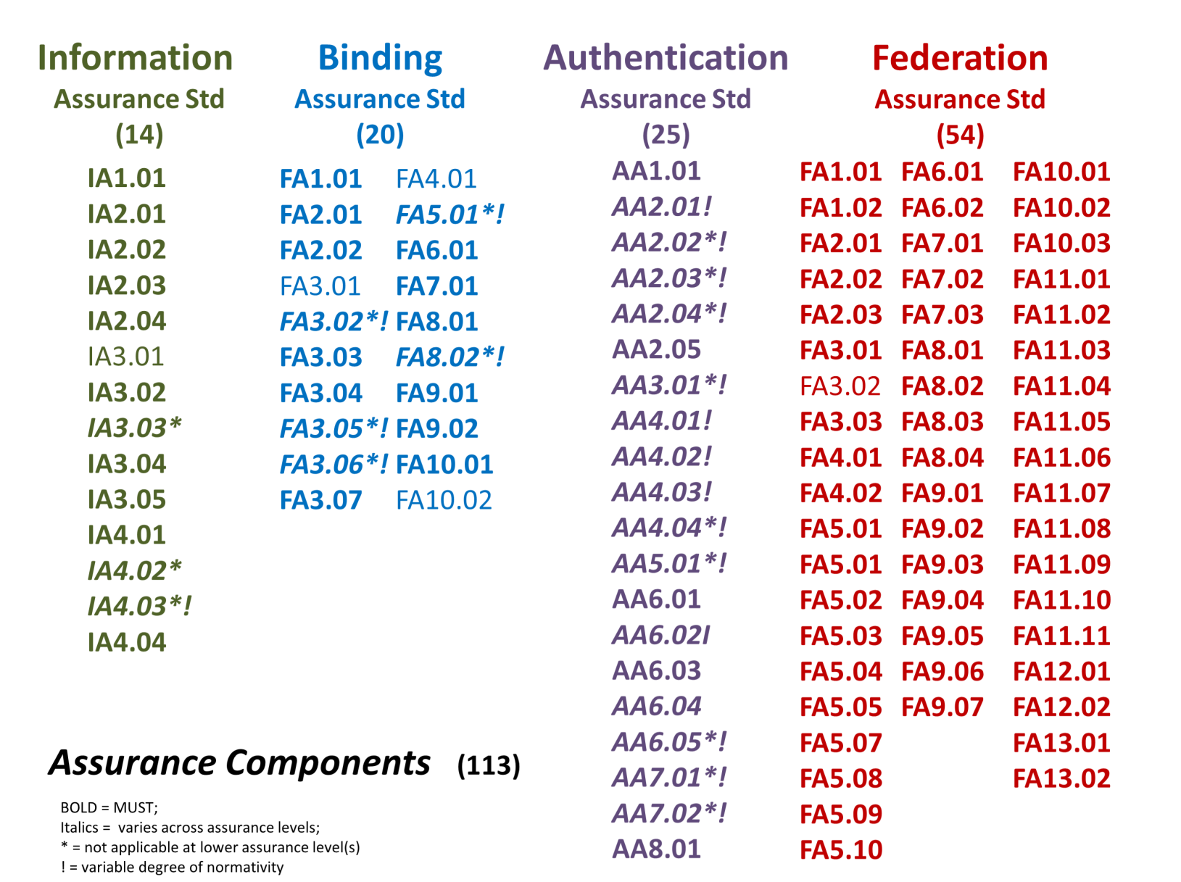
Specific Scope ?
❷

Slide 14
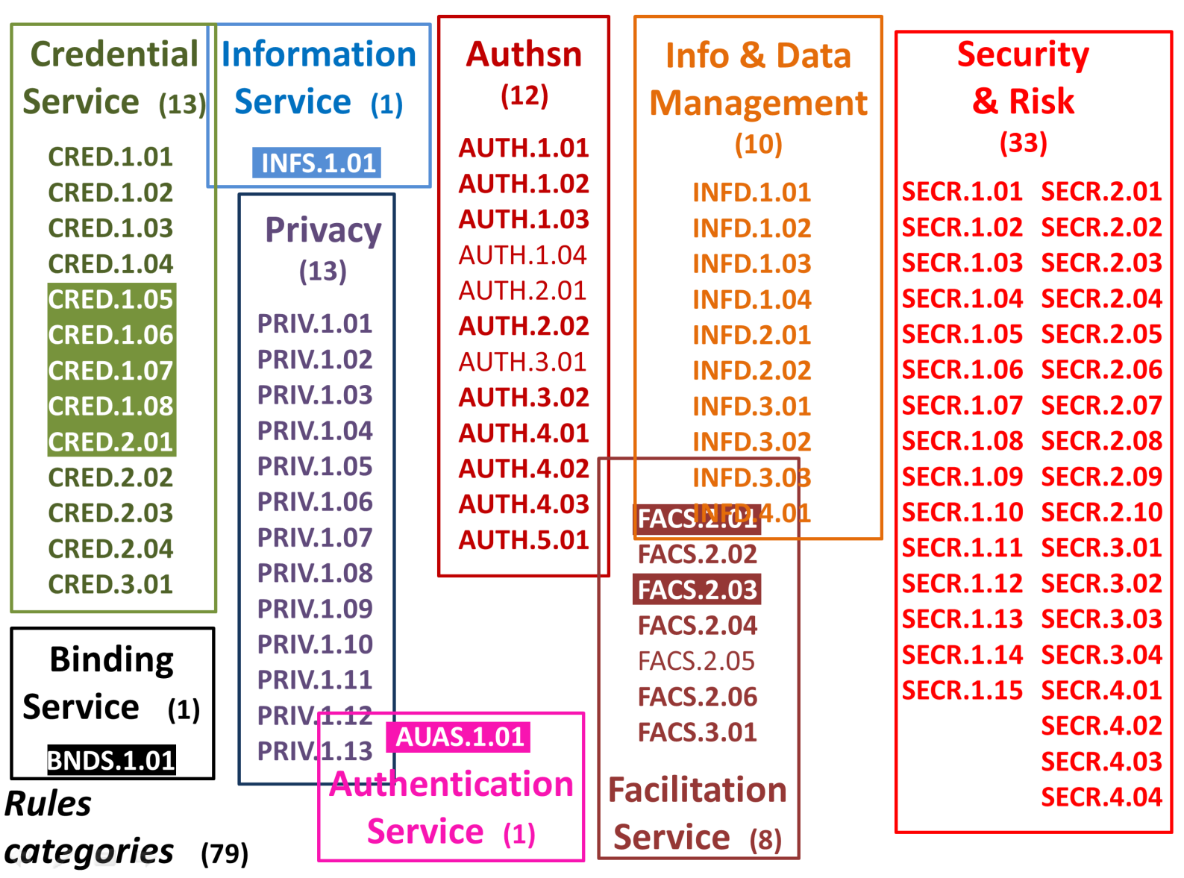
Specific Scope ?
❷

Slide 15
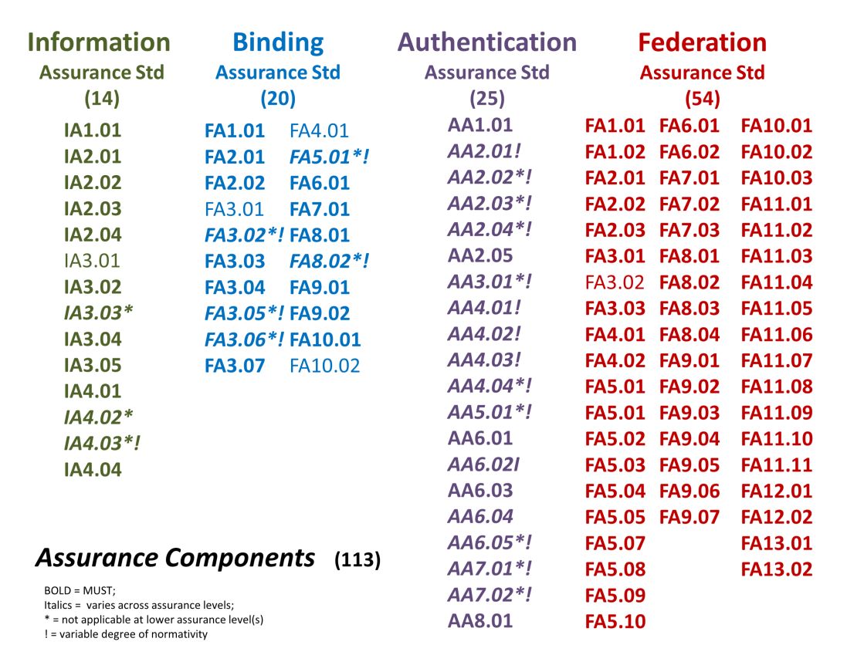
Specific Scope ?
❷
+ other Guidance

Slide 16
❷
Specific Scope ?
Applicability of which criteria (rules & controls) to which service or process is not immediately discernible
Functions performed by the identified services need to be more distinctly defined
W TF
hat’s he unction?

Slide 17
Specific Scope ?
❷
Applicability of which criteria (rules & controls) to which service or process is not immediately discernible
Functions performed by the identified services need to be more distinctly defined
‘information’ can be related to many types or classifications. Specifically ‘entity information’ could be: ‘identity information’ required to establish a unique id; ‘attribute information’ relating to an established identity; ‘credential status information’ relating to credentials bound to established identities; etc.

Slide 18
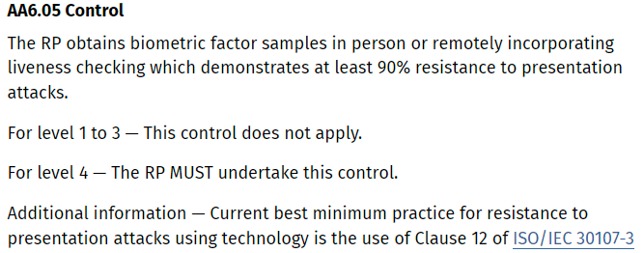
❶
Clear, Unambiguous Criteria
‘at least 90%’ does it – should anyone care what ‘best minimum practice’ is?
Might it be better to require “meeting or exceeding the parameters stated in [the latest edition of] ISO/IEC 30107-3”?

Slide 19
❸
Is this measurable ?
[snip]
If a control is ‘optional’, is it really a control? Is it effectively synonymous with ‘does not apply’? (see previous comment re. levels & minima)
In addition, (as already noted) some ‘level’ requirements state ‘SHOULD’ – inconsistent phraseology

Slide 20
❸
Is this measurable ?
[snip]
This additional information implies that different actions or controls (requirements) exist … but they are not stipulated
So … who cares, or who should care?

Slide 21
Oddities
❶
Isn’t this implicit, i.e. all ‘CRED.n.nn’ rules apply to a credential service?
Inconsistent – no other ‘service’ rule sets have such a stipulation (nor, in this presenter’s opinion, should they need one)
Is there value in this Rule? It could never be judged/assessed until all other Rules/Controls had been met.

Slide 22
Oddities
❶
For the sake of being explicit, Approved Cryptographic Algorithms are in §17.2 of the NZISM
§17 contains a plethora of Controls – can a service provider ignore these or are they, in toto or by a sub-set (§17.2?), included?
Does this lead to ambiguity concerning the applicability or not of any of the Controls (noting that many are explicitly applicable to ‘Agencies’)?

Slide 23
Consider …
❶
Criteria vs. Service type as a matrix:
Recognised Service Types
x
x
x
x
x
x
x
x
x
x
x
x
x
etc.
Set of Rules / Controls
Applicable LoA
x
x
x
x
x
x

Slide 24
Measurable Conformity
❸
Not everything is absolutely measurable – e.g. a Policy (even if specific scope / clauses / applicability are mandated)
Some things are measurable: entropy, time validities and expirations, availability, false match rates, …
Some measurability may require special services and attestations: reference standards & test lab reports e.g. crypto functions, other TF services
SP MUST allow
the applicable number of
The SP MUST apply this control with a limit of 100
The SP MUST apply this control with a limit of 30

Slide 25
Measurable Conformity
❸
This is perhaps measurable, but … – what am I not understanding about the hierarchy of levels?
How is an ‘equivalent level of complexity’ to be determined? - would stating a required minimum entropy be an enhancement?
Enforcing character mixes is no longer considered best practice – long memorable phrases are

Slide 26
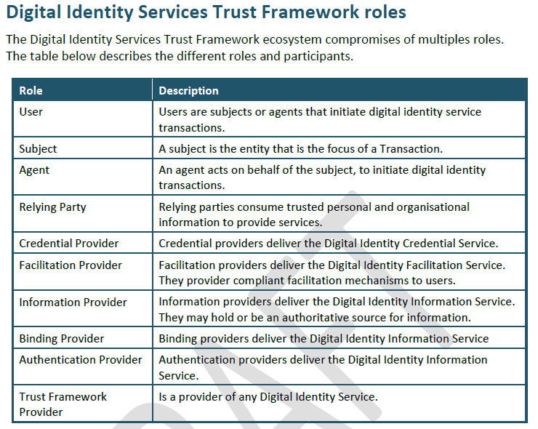
❷
Scope of Services

Slide 27
❷
Scope of Services
The Bill refers to but imposes no obligations upon Relying Parties within the scope of its provisions.
RPs should be the beneficiaries of having in place a robust TF and not be subject to assessment provisions.

Slide 28
Assessor Qualifications
❹
No requirements established thus far (the Bill asserts none)
Skills: established auditing practices, e.g. ISACA, ISMS, SOC, … something attested-to by a recognised third-party (i.e. an Accreditation Body)
Knowledge: familiarity with DISTF processes, procedures, criteria
Experience: initially, needs ‘boot-strapping’, but similar, e.g. Information Security, Privacy, Identity Management, … ?
Required qualifications can be broadly addressed under: - assessor entity standing (note – similar to TPs?) - assessor training/experience - assessor domain knowledge - assessor team leadership

Slide 29
Who will assess?
❺
The Bill (§26) allows for ‘periodic self assessment [and] reporting’
The Bill also (§38) allows for 3rd-party Assessors
There are international frameworks for recognizing assessors … - however, the Bill’s language is confused
ISO 17065 “Conformity assessment — Requirements for bodies certifying […] services” bodies which perform assessments are ACCREDITED bodies which deliver conformant services get CERTIFIED by accredited Certification Bodies
NB – the NZISM recognises auditing bodies as providing a CERTIFICATION service.

Slide 30
Who will assess?
❺
A member of the International Accreditation Forum
https://www.ianz.govt.nz/
https://www.ianz.govt.nz/regulators#serving-regulators

Slide 31
Rules and Processes
❻
Noted only that none are (or have been made) available - scope for continuing development, both for the TFA and those governing how and what TFPs and Assessors are required to do.

Slide 32
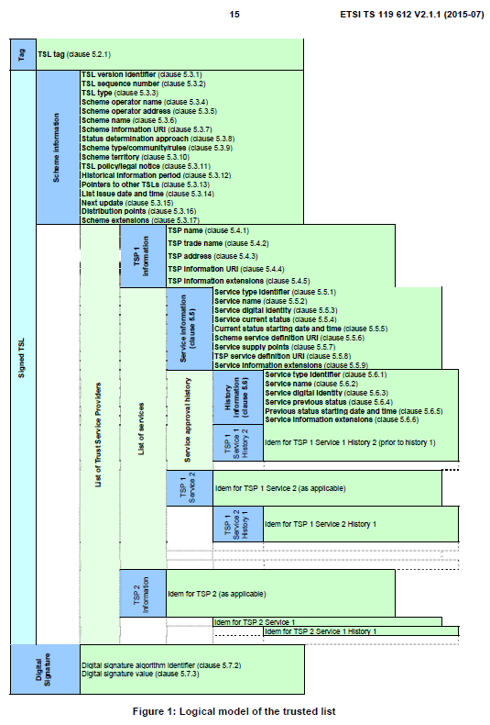
Maintaining the TF Register
❻
Bill §32 - §36 refers to a Trust Framework Register
Just a note – there is a well-established European standard for ‘Trusted Lists’: ETSI TS 119 612 v2.1.1 (2015-07) https://www.etsi.org/deliver/etsi_ts/119600_119699/119612/02.01.01_60/ts_119612v020101p.pdf

Slide 33
Gaps & Traps
Appears to be no recognition of proofing types - is proofing assumed to be done: supervised or not? If supervised, remotely or in-person? Does supervision demand a human or can an AI / Avatar do the job?

Slide 34
Gaps & Traps
Appears to be nothing which addresses proofing technology - is specialized technology and location/ infrastructure to be deployed or are users’ own mobile devices acceptable?

Slide 35
What is the Risk Basis?
What is the risk-based decisioning on which the standards and rules are based, and on which levels are differentiated? - without this being published it is hard to debate, and harder to consider, alternatives. Is it intelligent guesswork or is there a justifiable and documented rationale for these requirements?
Are the risks different according to proofing types and technologies?

Slide 36
Conclusions
The Trust Framework is yet to be realised in practice – esp. it has yet to be ‘operationalised’
There is a lot of work to be done, including significant ‘smoothing’
Why not take advantage of practices established elsewhere

Slide 37
Observations … I
It would help SPs and Assessors if the risk-base of the various controls was defined
Complexity could be reduced by evolving towards a singular set of Normative ‘requirements’
Clarity could be enhanced if the terminology and requirements were to:
identify the generally-recognized forms of id evidence and their processing, by LoA
package the controls according to service type
be definitive about information types?

Slide 38
Observations … II
Involvement of IANZ would facilitate the basis on which to ACCREDIT assessment/audit entities (i.e. establish CERTIFICATION BODIES)
Developing the operational aspects of the framework within DINZ would use the SPs’ experience and strengthen their commitment
UK’s tScheme has shown that professional bodies and service providers can self-manage within the auspices of regulations.

Slide 39
Observations… III
In continuing down the path towards a mature Trust Framework, TF Providers, Assessors and Regulators could benefit by considering how to develop:
Clear and unambiguous criteria (requirements)
Measurable conformity
Easily related to a specific scope of service
Defined skills / knowledge / experience of assessors
Defined rules / processes for both Service Providers and their Assessors
Defined rules / processes for the TFA’s functions

Slide 40
any questions?
I very much appreciate the invitation to present some of my thoughts to you today and the opportunity to e-meet you. Thank you for your interest.

